Slide 1
Hotel Aggregator Analysis
By Tanya Sharma

Slide 2
Section 1: Project Overview
Section 2: Data Analysis using Power BI
Section 3: Key Insights

Slide 3
Section 1: Project Overview
This project aims to analyze a dataset of hotel aggregator listings using Power BI.
The objective is to create comprehensive visualizations and insights that shed light on trends, patterns, and factors influencing the performance of listings.
This will help to explore key metrics such as pricing, availability, host characteristics, and review scores to derive actionable insights for improving the overall quality and
competitiveness of the listings.

Slide 4
Dataset Description:
Here's an understanding of the data :
The listings are a total of 23 ,185 with 75 unique columns/attributes . A variety of the datapoints captured are listings, hosts, reviews, availability

Slide 5
Section 2: Data Analysis using Power BI
Key Areas of Analysis :
• Geographical Insights : Where are the most popular locations and host concentrations?
• Pricing and Availability : How do prices vary based on property type, room type, and capacity? What are the peak availability periods?
• Host Performance : Does Superhost status, response time, or verification methods affect listing performance?
• Review Scores and Guest Satisfaction : How do review scores impact performance? Can we identify areas for improvement?
• Property Type and Room Analysis : What are the most popular property and room types? Are there any changing trends?

Slide 6
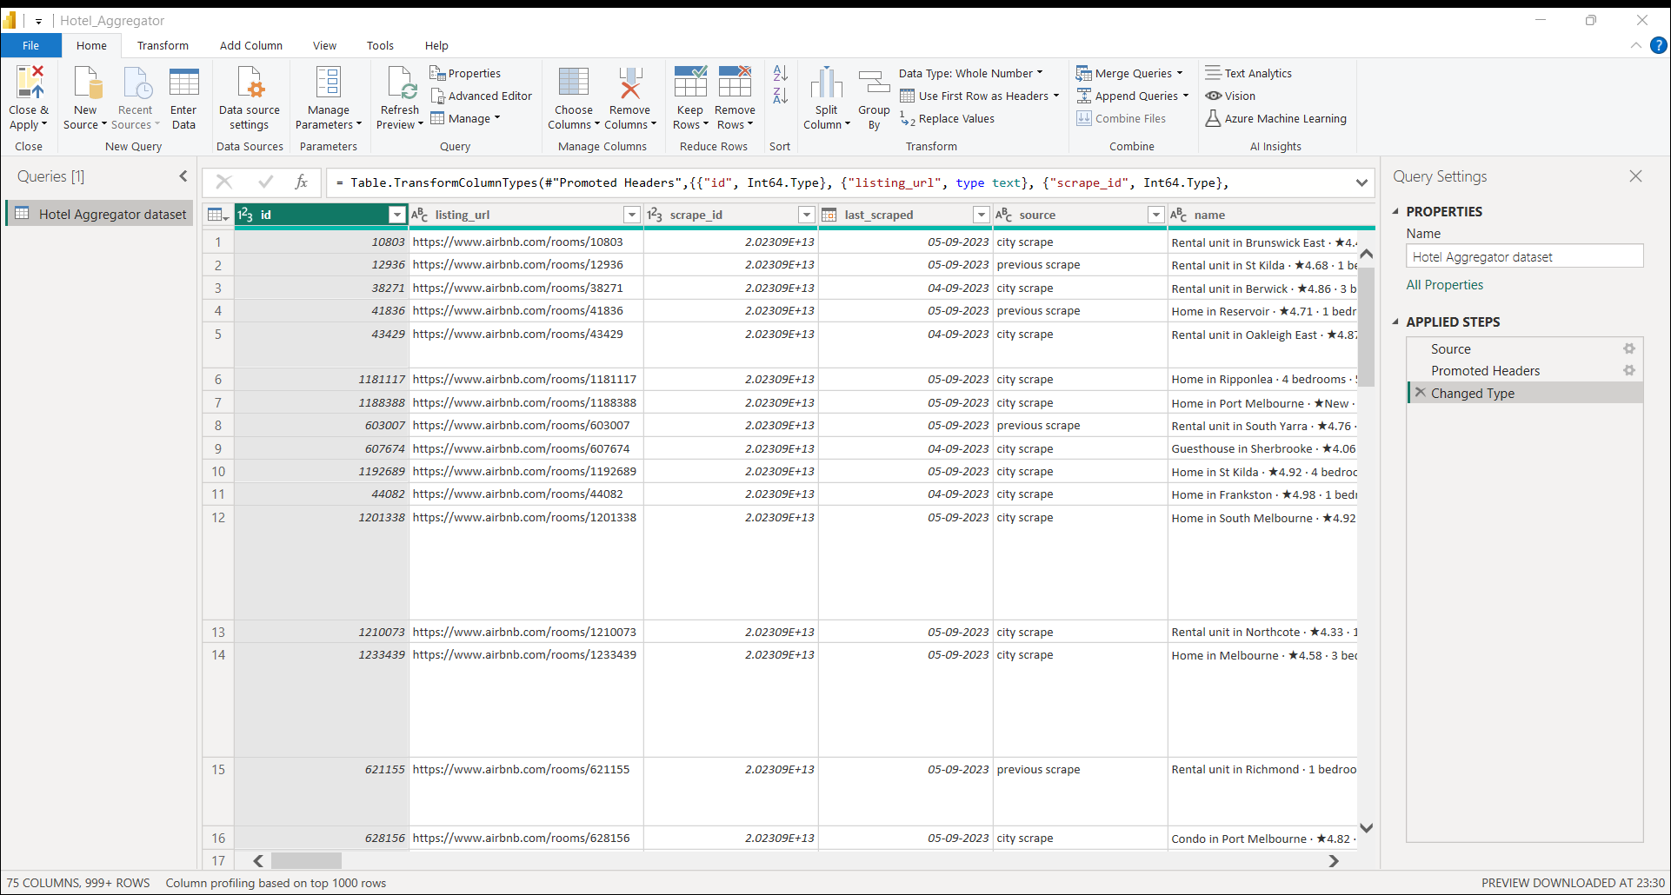
STEP 1 – Load & Transform Data Using Power Query

Slide 7
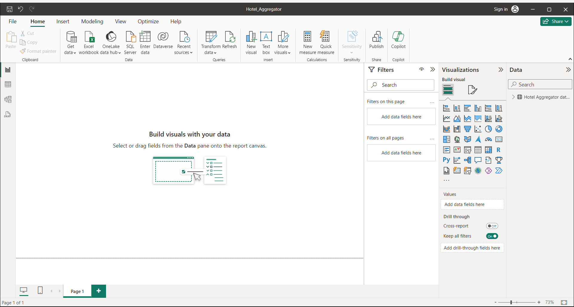
STEP 2 – Data Visualization Using Power BI

Slide 8
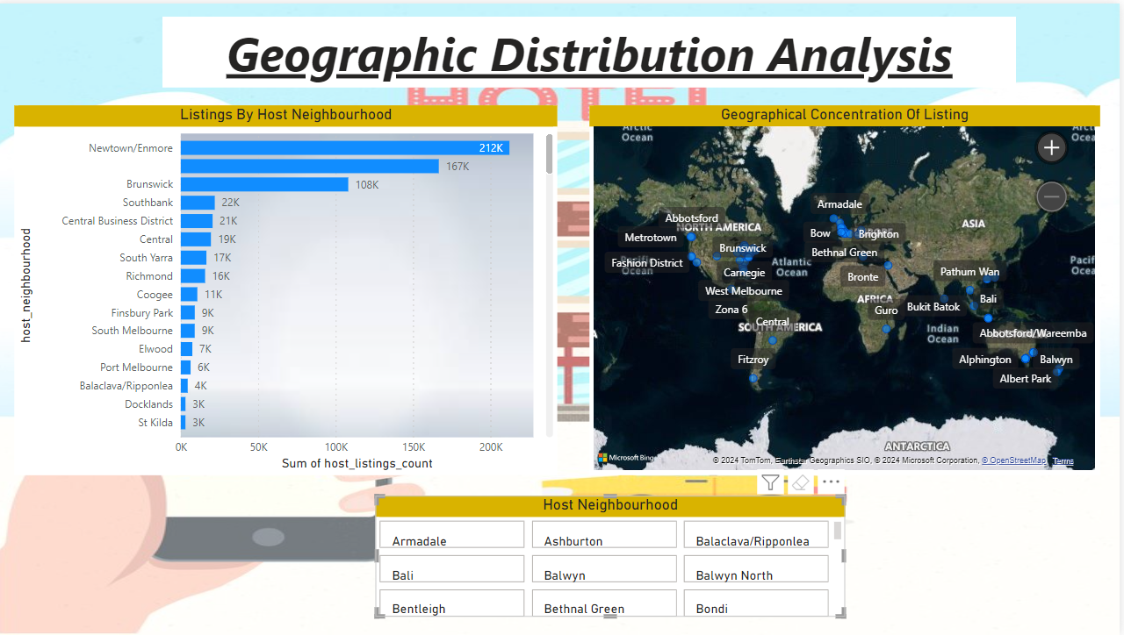
GEOGRAPHIC DISTRIBUTION ANALYSIS

Slide 9
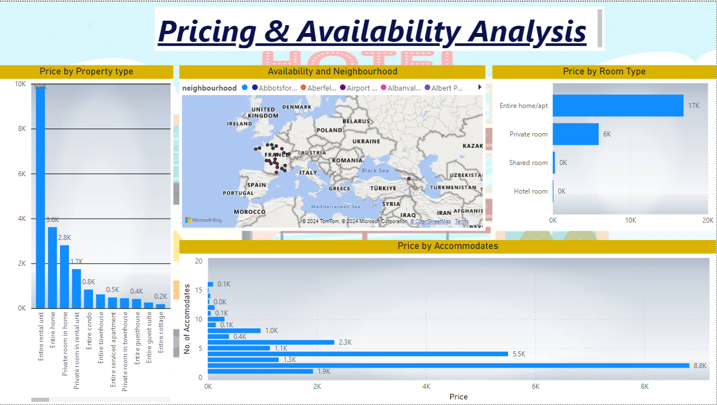
PRICING AND AVAILABILITY TRENDS

Slide 10
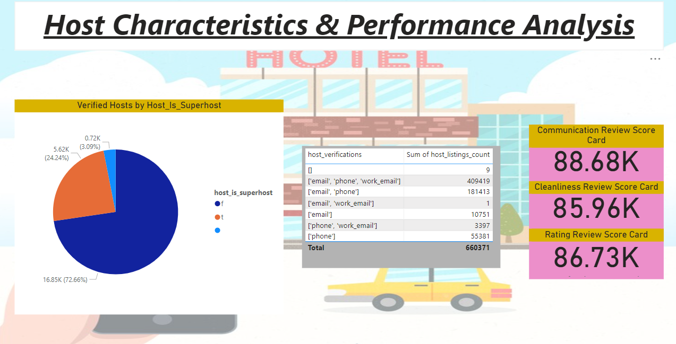
HOST CHARACTERISTICS & PERFORMANCE ANALYSIS

Slide 11
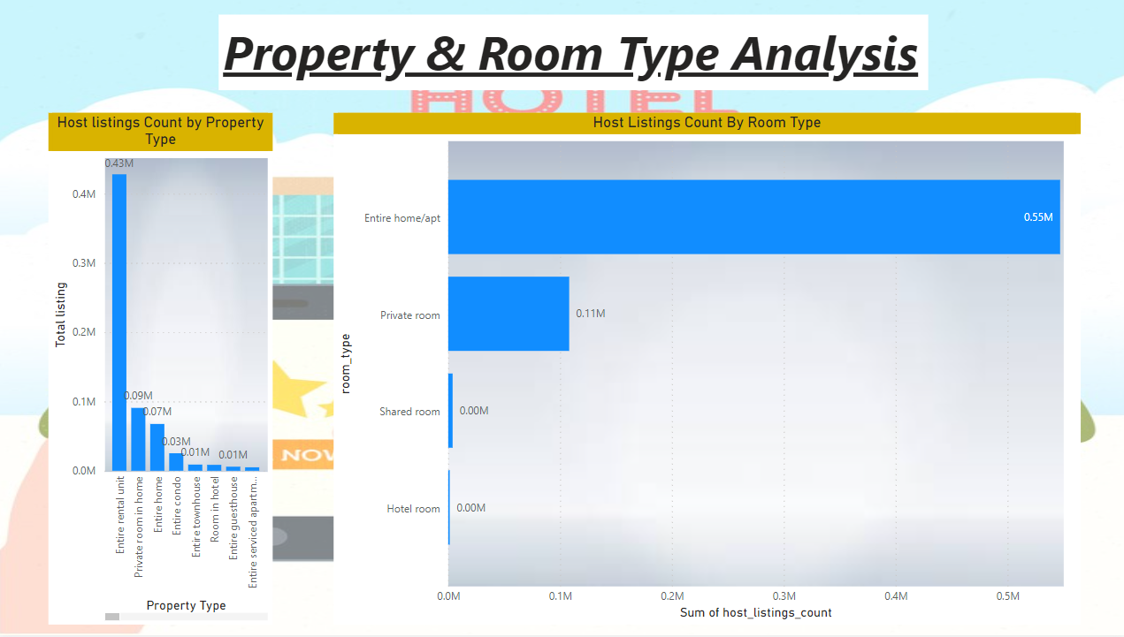
PROPERTY & ROOM TYPE ANALYSIS

Slide 12
Section 3: Key Insights
Findings:
1. Geographical Insights:
• Popular Neighborhoods: Melbourne (Australia) with 31% listings, followed by Port Phillip with 11%.
• Host Concentration: High concentrations of hosts are recorded in Newton/Enmore Neighborhood.
2. Pricing and Availability Analysis:
• Pricing Trends: Highest prices are recorded for Casa Particular property Avg Price $9652.50.
• Room type best sellers: Entire home/apt $261.61.
• Availability Patterns: The highest availability pattern was recorded in 2016.
3. Host Performance:
• Superhost Impact: A total of 72.6% of votes are “False” on Superhost influence on Listings Performance.
• Response Time and Verification: These features positively affected the results and performance with 5 start rating.

Slide 13
4. Review Scores and Guest Satisfaction:
• Review Score Impact: The higher the response & acceptance rate, the higher the review score to up to 5 star.
• Areas for Improvement: Cleanliness can be improved.
5. Property Type and Room Analysis:
• Property Distribution: The most prevalent property type is an Entire Rental Unit, 42.5% of listings. Second, entire homes that account for 15% of the 23,185 listings.
• Room Type Trends: Most popular room types are entire home/apt followed by private room.

Slide 14
Recommendations:
• Targeted Listings : Based on popular neighborhoods and property/room type trends, hosts can optimize their listings to cater to specific guest preferences in high -demand areas .
• Pricing Strategies : Pricing strategies should consider factors like property type, room capacity, and peak seasons .
• Host Support : The source platform should offer resources or incentives to encourage faster response times, increased host verification methods all of which can positively impact listing performance .
• Guest Feedback Integration : Integrate guest feedback from reviews into listing improvement suggestions for hosts . This can address areas like cleanliness or amenities .

Slide 15
Conclusion:
By understanding geographical trends, pricing dynamics, host characteristics, and guest satisfaction factors, the platform can empower hosts to optimize their listings and attract more bookings. Utilizing these insights, the platform can further enhance its overall listing quality and competitiveness in the market.

Slide 16

THANK YOU

